Slide 1
Additional vertical datums (in S-100 discovery metadata) S-100 TSM8 2-4 March 2021
Raphael Malyankar

Slide 2
Additional vertical datums
S-104 (and/or S-111) will use datums not enumerated in S-100 Ed. 4.0.0 Part 4a.
May want to state EPSG codes for vertical datums in discovery metadata, as allowed in S-100 Edition 5.0.0 carrier metadata.
TWCWG will discuss the additions at TWCWG5 and finalize the list before a final proposal is prepared.
Name | Description | Code | Remarks
ITRF2014 | International Terrestrial Reference Frame 2014 | ?
ITRF2020 | International Terrestrial Reference Frame 2020 | ? | [determination underway]
ellipsoidalHeightGeneric | Ellipsoidal height (generic) | ? | Ellipsoidal height for an ellipsoid not specifically named in the list of datums.
balticSeaChartDatum2000 | Baltic Sea Chart Datum 2000 | 44
geoidGeneric | Geoid (generic) | ? | Geoid not specifically named in the list of datums
internationalGreatLakesDatum2020 | International Great Lakes Datum 2020 | ? | [determination underway]
seaSurface | Sea surface | ? | A two-dimensional (in the horizontal plane) field representing the air-sea interface, with high-frequency fluctuations such as wind waves and swell, but not astronomical tides, filtered out
seaBottom | Sea bottom | ? | Local sea bottom reference
Notes:
Sea surface is used in S-111.
Mechanism for proposing new EPSG codes desired by S-100 product specifications?
Would prefer not to use the two “generic” datums, whence the proposed change in datatype on the next slide.

Slide 3
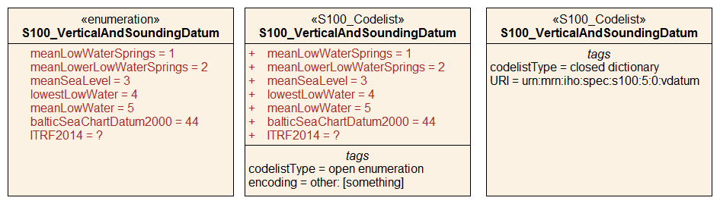
Datatype of verticalDatum in S-100 discovery metadata (Fig. 4a-D-4)
Current S-100 4.0.0
+ additional datums
Proposed alternative 1
Modify datatype to
Open enumeration codelist
Proposed alternative 2
Modify datatype to
Dictionary codelist
Alternative 3: S100_DatasetDiscoveryMetadata.otherVerticalDatum: CharacterString [0..1].
Not being machine-processable, this is not the recommended solution.

Slide 4
Encoding of verticalDatum in discovery metadata XML
Current (S-100 4.0.0):
If enumerated:
<S100XC:verticalDatum>meanLowWaterSprings </S100XC:verticalDatum>
If unenumerated, omit verticalDatum or encode as empty element with nilReason attribute:
<S100XC:verticalDatum xsi:nil="true" gco:nilReason="other: not enumerated"/>
or
<S100XC:verticalDatum xsi:nil="true" gco:nilReason="other: ITRF2014"/>
With open enumeration codelist:
If enumerated:
<S100XC:verticalDatum>meanLowWaterSprings</S100XC:verticalDatum>
If unenumerated:
<S100XC:verticalDatum>other: EPSG 1234</S100XC:verticalDatum>
With dictionary codelist:
<S100XC:verticalDatum codeList=“urn:mrn:iho:spec:s100:5:0:vdatum”
codeListValue=“meanLowWaterSprings” />
Not machine-processable!
Searchable key in the datums dictionary file
Notes:
“not enumerated” and “ITRF2014” in nilReason are free text, cannot be checked, and are not suited to machine processing

Slide 5
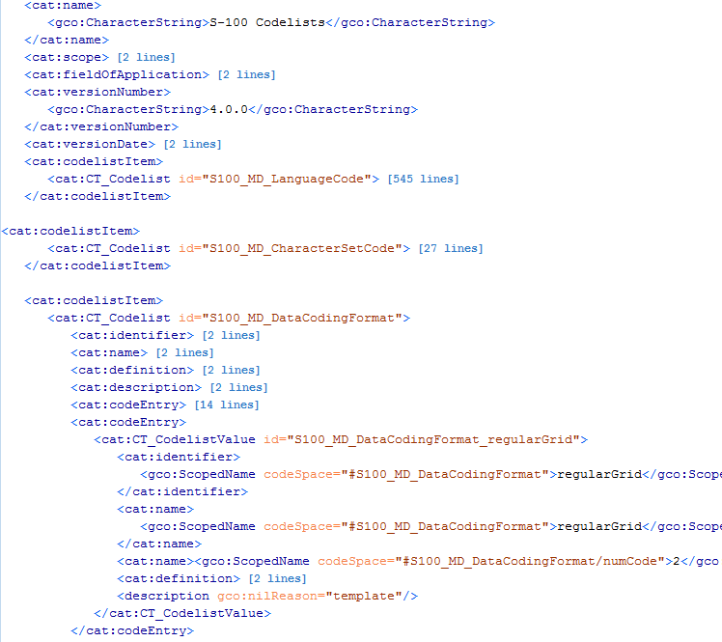
ISO 19115 codelists dictionary example - for information
The S-100 4.0.0 schemas package on the S-100 GitHub site contains codelist dictionaries for both ISO 19115-x and S-100 codelists.

